Slide 1

Customer Shopping Behavior Analysis
This project analyzes customer shopping behavior using transactional data to uncover insights into spending patterns, customer segments, product preferences, and subscription behavior. Our goal is to guide strategic business decisions.

Slide 2

Project Overview
Data-Driven Insights
Strategic Decisions
Analyzed 3,900 purchases to understand customer behavior.
Insights will inform business strategies for growth and efficiency.
Key Areas
Focused on spending, segments, product preferences, and subscriptions.

Slide 3

Dataset Summary
Data Volume
3,900 rows and 18 columns of transactional data.
Key Features
Customer demographics (Age, Gender, Location, Subscription)
Purchase details (Item, Category, Amount, Season, Size, Color)
Behavioral data (Discount, Promo, Previous Purchases, Frequency, Review, Shipping)
Missing Data
37 missing values in the Review Rating column, handled during cleaning.

Slide 4

Exploratory Data Analysis: Python
Data Loading
Imported dataset using pandas for initial processing.
Initial Exploration
Used df.info() and .describe() for structural and summary insights.
Missing Data Handling
Imputed missing 'Review Rating' values using median per category.
Column Standardization
Renamed columns to snake case for improved readability.
Feature Engineering
Created 'age_group' and 'purchase_frequency_days' columns.
Database Integration
Loaded cleaned data into PostgreSQL for SQL analysis.

Slide 5

Data Analysis: Key SQL Insights
Revenue by Gender
Top 5 Products by Rating
Male customers generated $157,890, female customers $75,191.
Gloves (3.86), Sandals (3.84), Boots (3.82), Hat (3.80), Skirt (3.78).
Shipping Type Comparison
Express shipping had a higher average purchase amount ($60.48) than Standard ($58.46).

Slide 6

Customer Spending & Discounts
High-Spending Discount Users
Identified 839 customers who used discounts but still spent above average.
Discount-Dependent Products
Products with highest percentage of discounted purchases:
Hat (50.00%)
Sneakers (49.66%)
Coat (49.07%)
Sweater (48.17%)
Pants (47.37%)

Slide 7



Subscription & Age Group Insights
Revenue by Age Group
Young Adults: $62,143
Subscribers vs. Non-Subscribers
Middle-aged: $59,197
Adult: $55,978
Subscribers (1,053) had an average spend of $59.49, non-subscribers (2,847) averaged $59.87.
Senior: $55,763
Repeat Buyers & Subscriptions
958 repeat buyers (>5 purchases) are subscribers, 2,518 are not.

Slide 8



Customer Segmentation
New
1
83 Customers
Returning
2
701 Customers
Loyal
3
3,116 Customers

Slide 9
Top Products by Category
1
Accessories
Jewelry
171
2
Accessories
Sunglasses
161
1
Clothing
Blouse
171
2
Clothing
Pants
171
1
Footwear
Sandals
160
1
Outerwear
Jacket
163

Slide 10
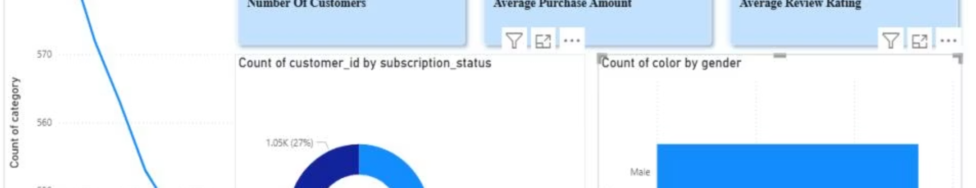
Power BI Dashboard: Visualizing Insights
3.9K
$59.76
3.75
Customers
Avg. Purchase
Avg. Review

